Slide 1
NYC Quest for a good good place to stay
Using FourSquare API

Slide 2
the problem and the background
I will visit NY city this summer for a business trip. I will take with me my mini pig Sammy with me. I am afraid that because of stress and jet lag Sammy may catch a cold or some kind of “mal de mer”.
So, I need to make a list of vet clinics in the areas (boroughs) of NYC and put them on a map to help me to identify the best place for a room rent, where I will stay for the trip.

Slide 3
Data acquisition and cleaning
Get the coordinates of NYC centre. According to https://www.latlong.net the latitude of New York City, NY, USA is 40.730610, and the longitude is -73.935242.
According to Wikipedia (https://en.wikipedia.org/wiki/New_York_City#Geography) the area of NYC is 1213.37 square km, so if we assume that 1213.37 is the square of the circle, we can easily count its radius - 8.921 km.
Of course NYC is not circular by its shape, so we will need to make sure that vet clinics are situated in NYC, but not in New Jersey or other places.
Using Foursquare API collect the data frame of vet clinics.
Prepare the data for the research, clean unnecessary and irrelevant data.
Put all the clinics on the map and obtain a list of hotels near the place.

Slide 4
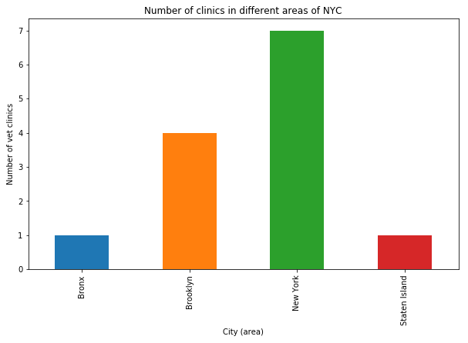
Number of clinics in different areas of NYC

Slide 5
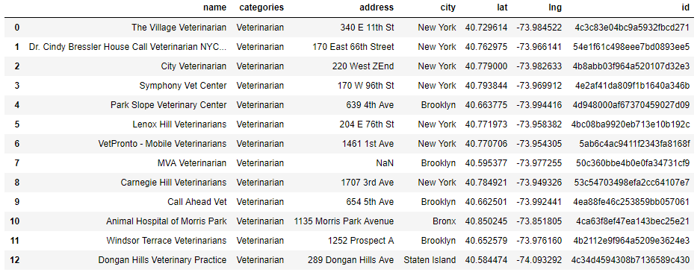
Cleaned Data frame, ready for research

Slide 6
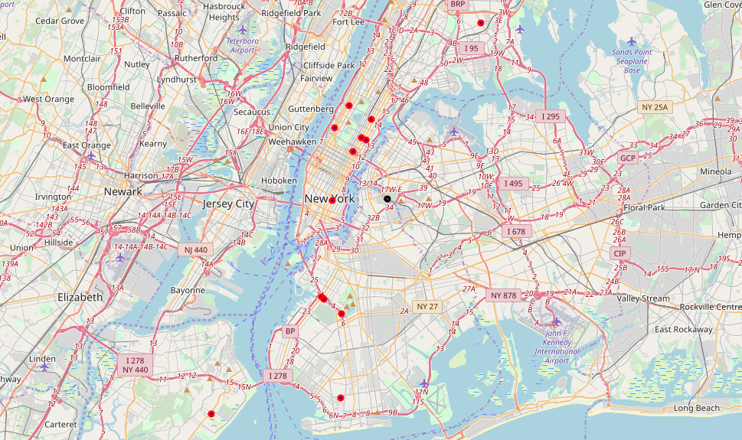
map centered around the NYC search area

Slide 7
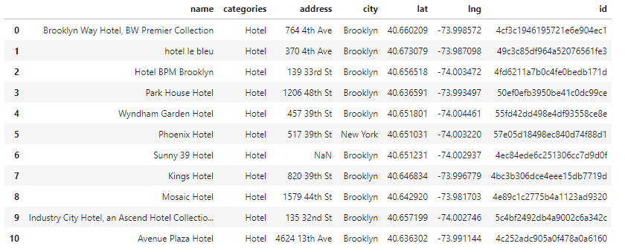
Lets Fetch all the hotels around Green-Wood Cemetery, Brooklyn

Slide 8
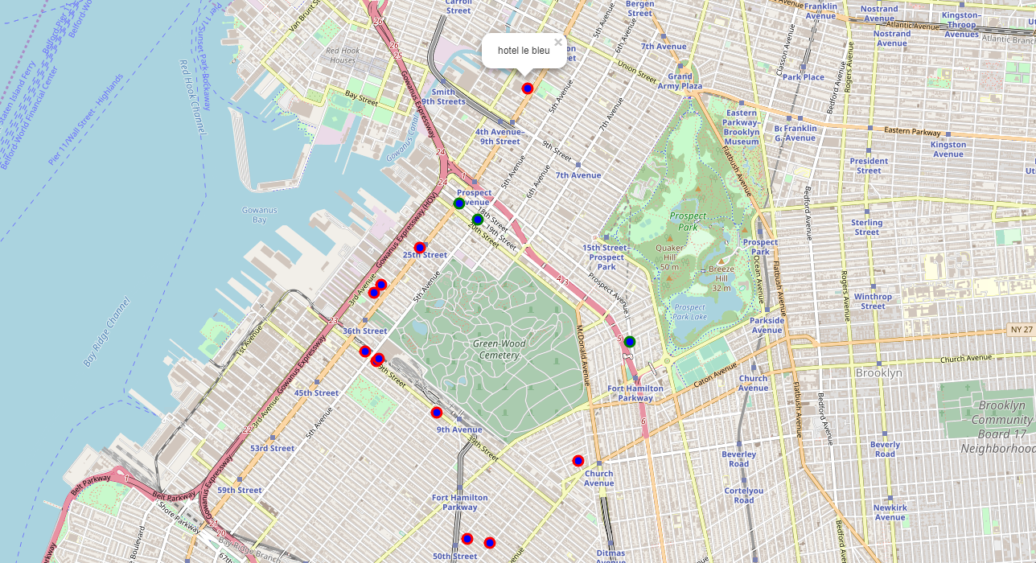
The result

Slide 9
Conclusion and future directions
“Hotel le bleu” with 6.8 rating is the best choice for the case.

